Slide 1
CS5199 Demonstration: Breast Cancer Detection In Low-Resolution Images
Nathan Poole (170004680)
Supervisors: Christina Fell, Dr David Harris-Birtill

Slide 2
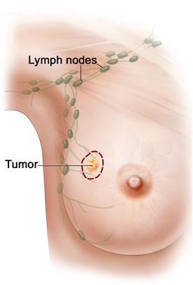
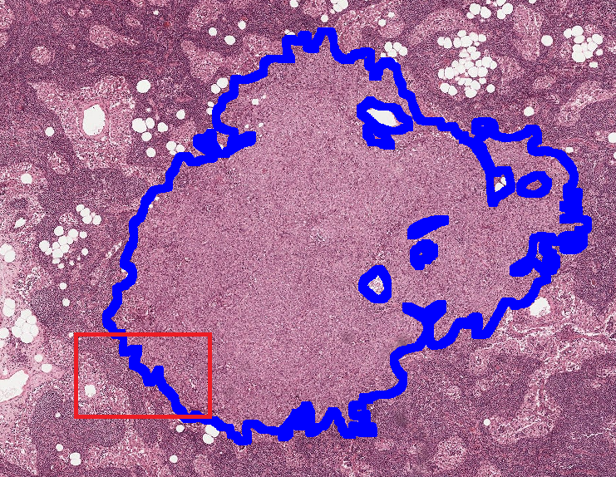
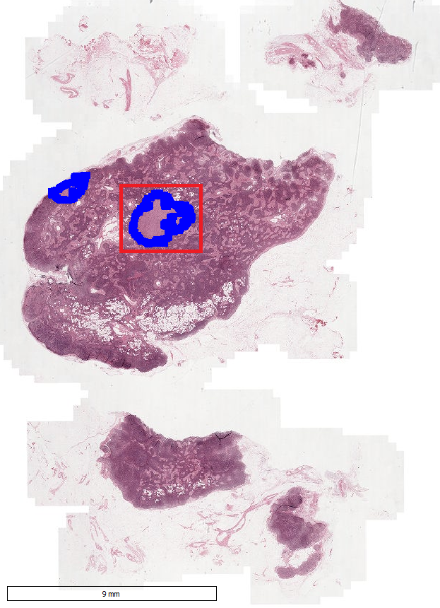
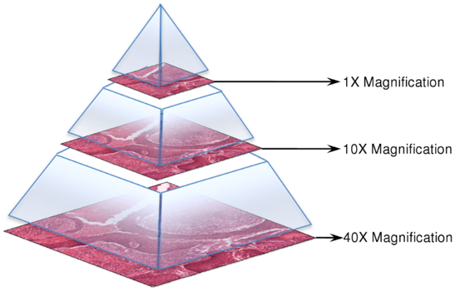
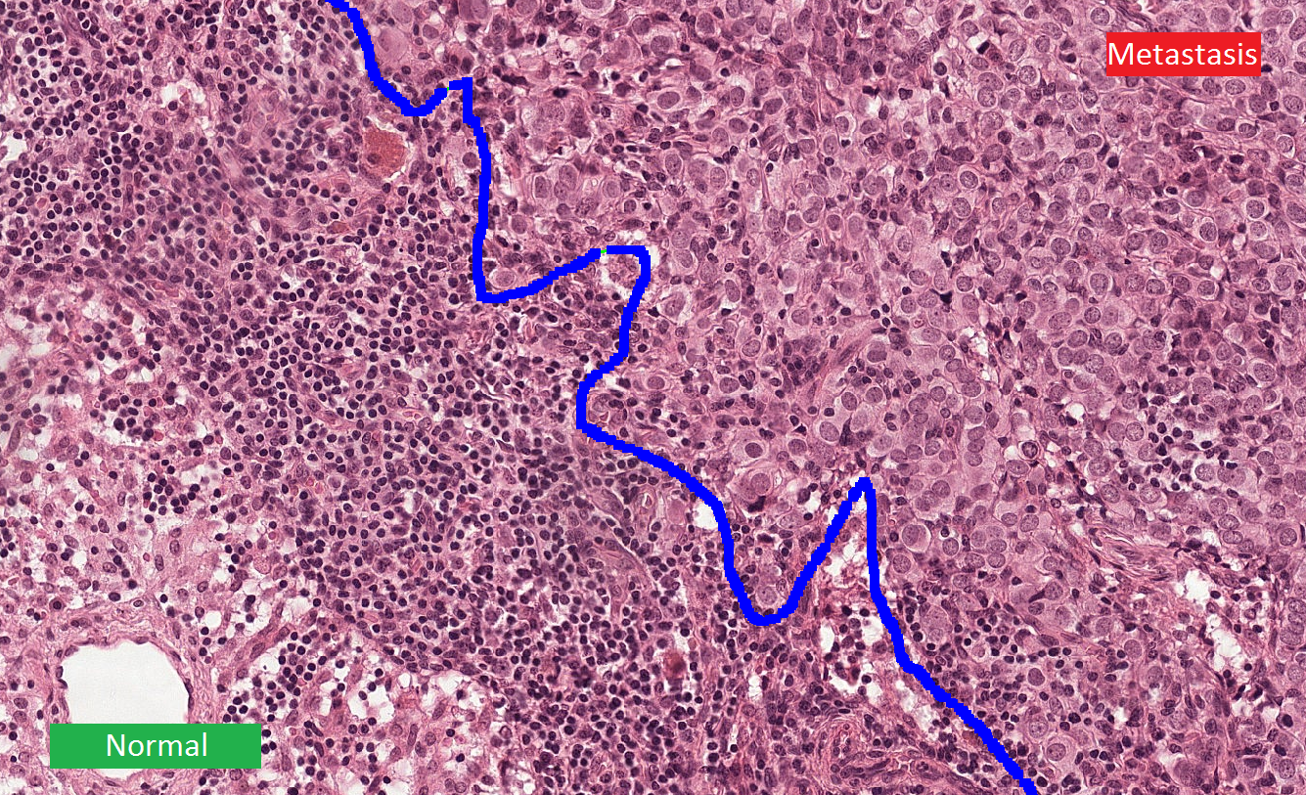
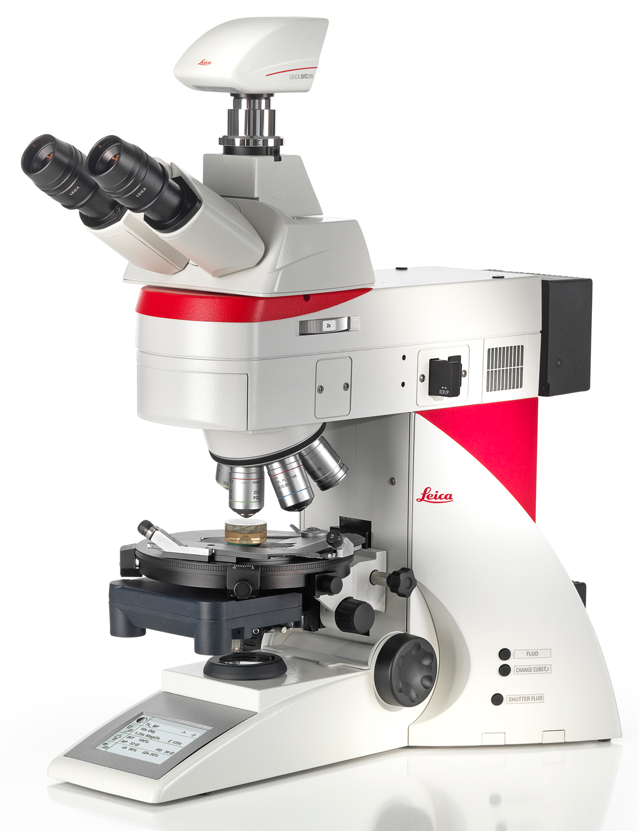
Context:
* Images from https://camelyon17.grand-challenge.org/

Slide 3
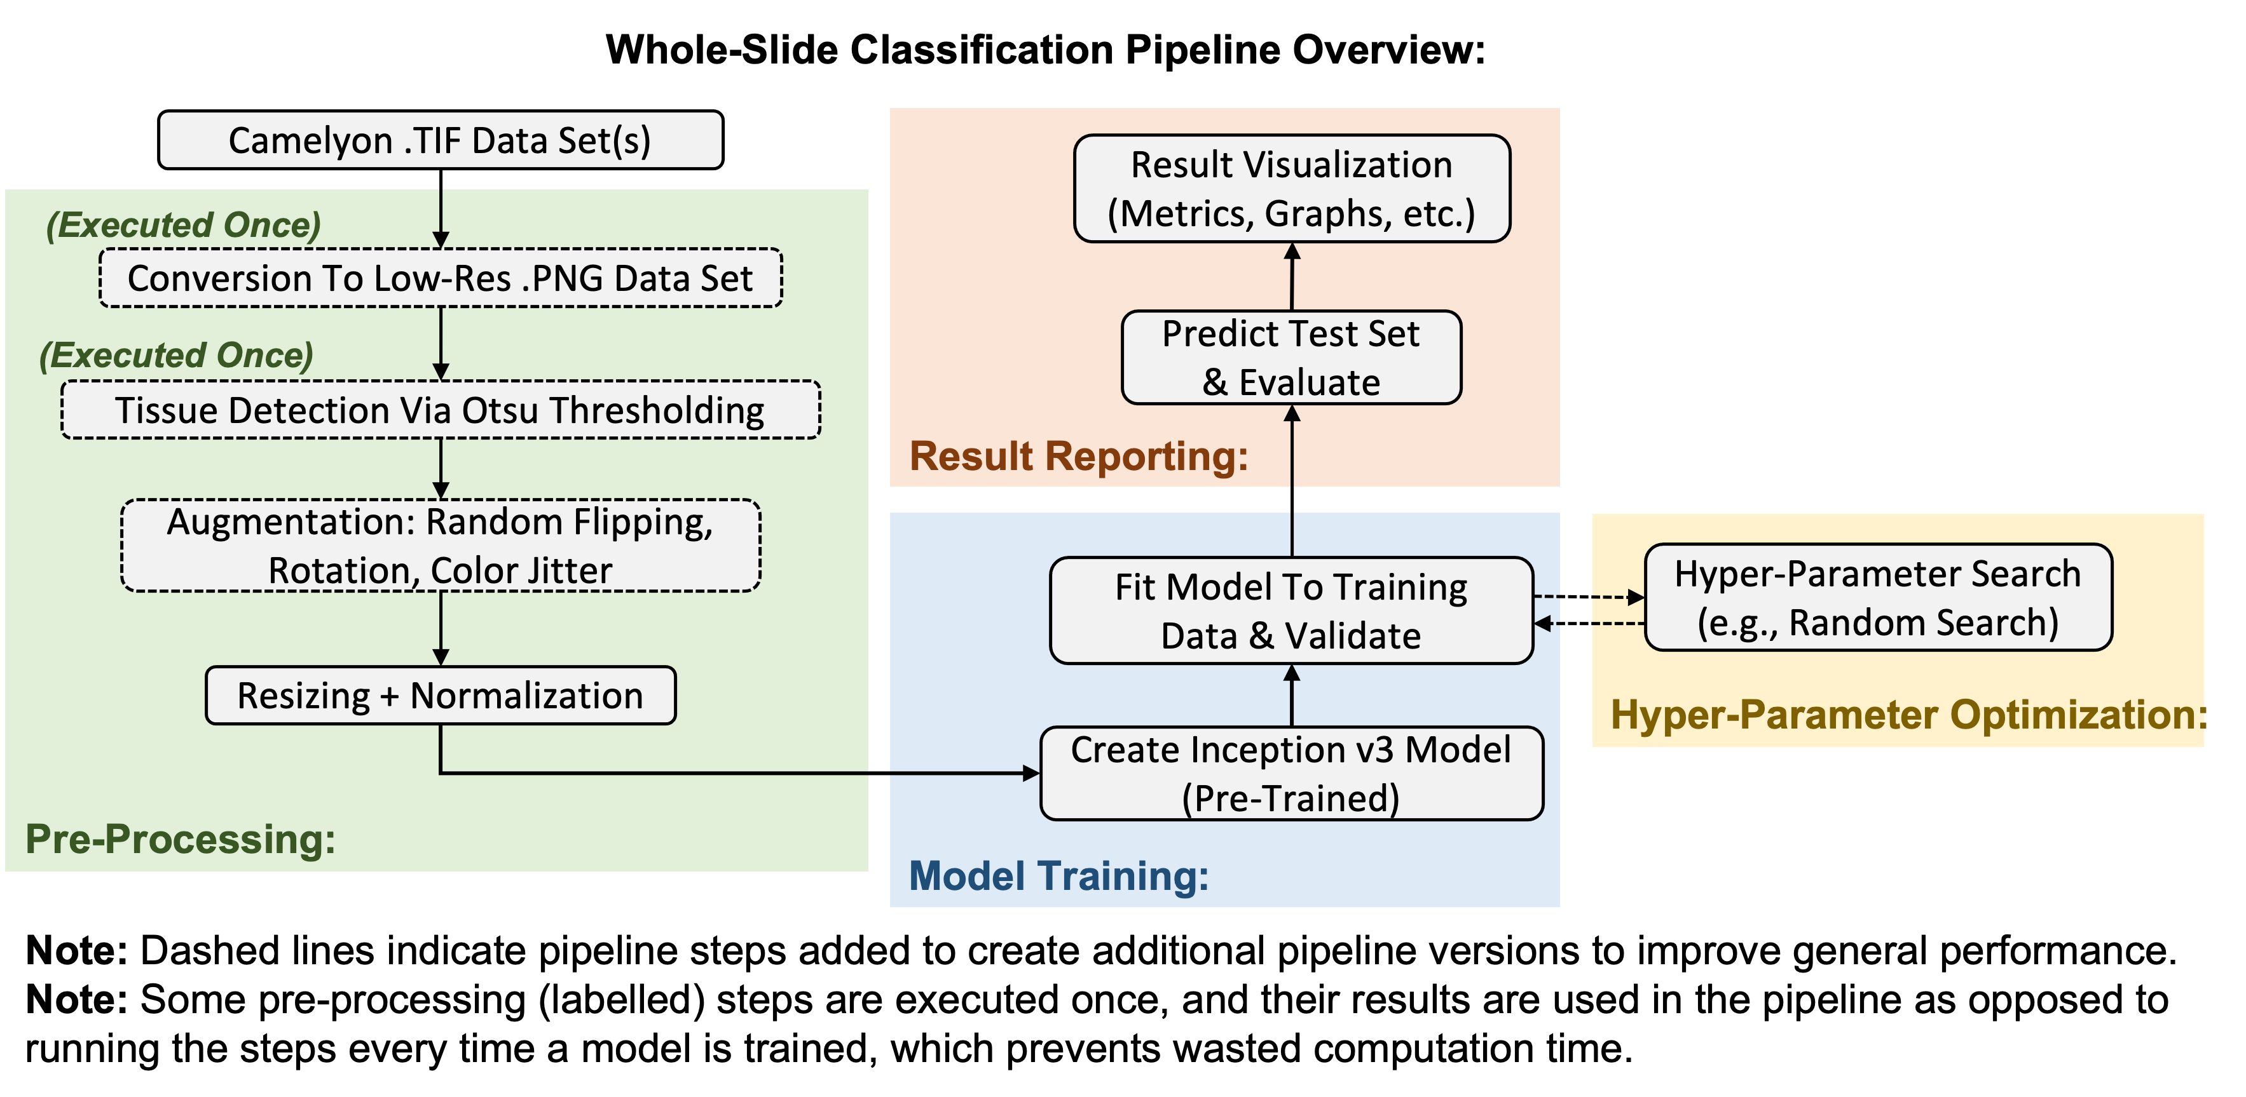

Slide 4
Implementation:
1_generate_lowres_images.py
2_generate_image_labels.py
3_filter_image_black_content.py
classification_infer.py
4_generate_tissue_images.py
5_generate_images_mean_std.py
classification_train.py

Slide 5
Results / Conclusions:
Significant decrease in average inference time (order: seconds).
→ Compared to the Camelyon-16 submissions (order: minutes).
Ultimately, a superficial benefit…
AUC scores misrepresentative/misleading.
Optimised models cannot separate the test data set.
Classification performance is more important.
Possible causes:
Poor input quality (need higher resolution)
Insufficient training (need more training samples)
Conclusion:
The developed low-resolution pipeline is insufficient for use at the investigated input resolutions.

Slide 6
Questions

